Slide 1
Data Structure
Linked Lists
By
Dr. Mudassar Raza
Professor
Department of Computer Science
Namal University Mianwali

Slide 2
Why Linked List?
Problem with Arrays:
Fixed size
Memory wastage
Difficult insertion/deletion (shifting required)
Insertion/Deletion is costly in arrays
Linked Lists allow dynamic memory allocation
Linked List Solution:
Dynamic size
Efficient insertion/deletion
Non-contiguous memory allocation

Slide 3
What is a Singly Linked List?
A linear data structure where:
Each node contains:
Data
Pointer to next node
Last node points to NULL
10 | next
20 | next
30 | next
NULL

Slide 4
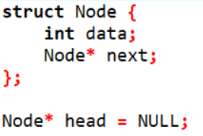
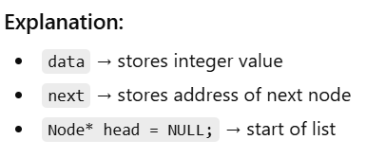
Structure Definition (From Code)

Slide 5
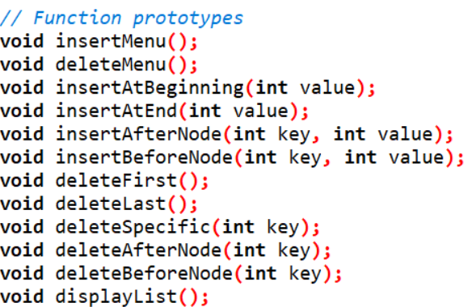
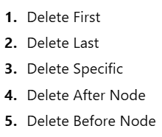
List Operations
Insert at the beginning
Insert at last
Insert after specific node
Insert after specific node
1. Insert 2. Delete 3. Display

Slide 6
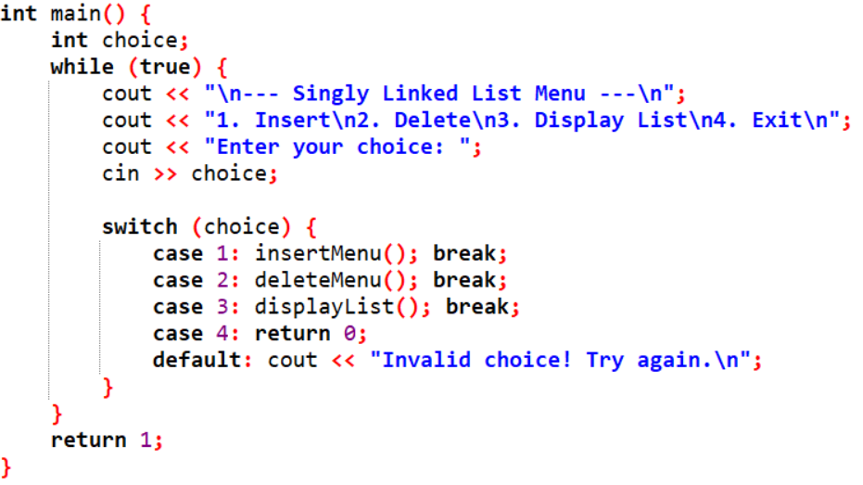
Main Program
1. Insert 2. Delete 3. Display

Slide 7
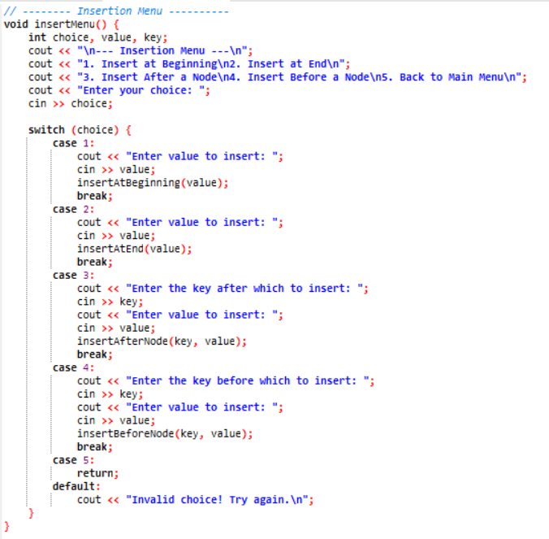
Insert Menu

Slide 8
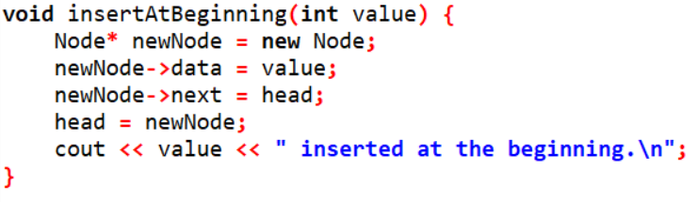
Insert Menu
newNode
-- | ----
newNode
head
-- | ----
10 | next
20 | next
31 | next
NULL

Slide 9
Insert Menu
newNode
30| next
newNode
head
30 | next
10 | next
20 | next
31 | next
NULL

Slide 10
Insert Menu
newNode
head
30| next
NULL
newNode
head
30 | next
10 | next
20 | next
31 | next
NULL

Slide 11
Insert Menu
head
newNode
30| next
NULL
head
newNode
30 | next
10 | next
20 | next
31 | next
NULL

Slide 12
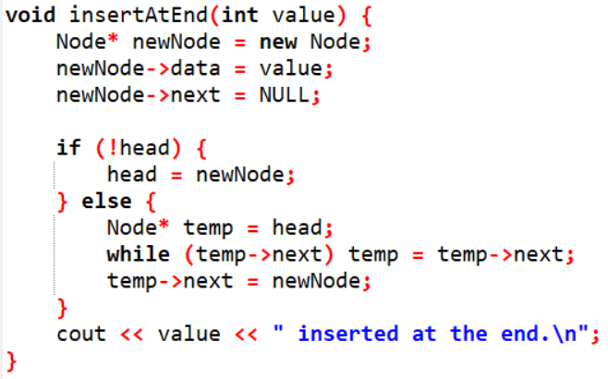
Insert Menu
head
newNode
--| next
newNode
-- | next
head
10 | next
20 | next
31 | next
NULL

Slide 13
Insert Menu
head
newNode
30| next
newNode
30| next
head
10 | next
20 | next
31 | next
NULL

Slide 14
Insert Menu
head
NULL
newNode
30| next
NULL
newNode
30 | next
NULL
head
10 | next
20 | next
31 | next
NULL

Slide 15
Insert Menu
head
NULL
newNode
30| next
NULL
newNode
30 | next
NULL
head
10 | next
20 | next
31 | next
NULL

Slide 16
Insert Menu
head
newNode
30| next
NULL
newNode
30 | next
NULL
head
10 | next
20 | next
31 | next
NULL

Slide 17
Insert Menu
newNode
30 | next
NULL
head
10 | next
20 | next
31 | next
NULL

Slide 18
Insert Menu
newNode
30 | next
NULL
head
10 | next
20 | next
31 | next
NULL

Slide 19
Insert Menu
newNode
30 | next
NULL
head
temp
10 | next
20 | next
31 | next
NULL

Slide 20
Insert Menu
//while(temp->next != NULL) temp= temp-next;
newNode
30 | next
NULL
head
temp
10 | next
20 | next
31 | next
NULL

Slide 21
Insert Menu
//while(temp->next != NULL) temp= temp-next;
newNode
30 | next
NULL
head
temp
10 | next
20 | next
31 | next
NULL

Slide 22
Insert Menu
//while(temp->next != NULL) temp= temp-next;
newNode
30 | next
NULL
head
temp
10 | next
20 | next
31 | next
NULL

Slide 23
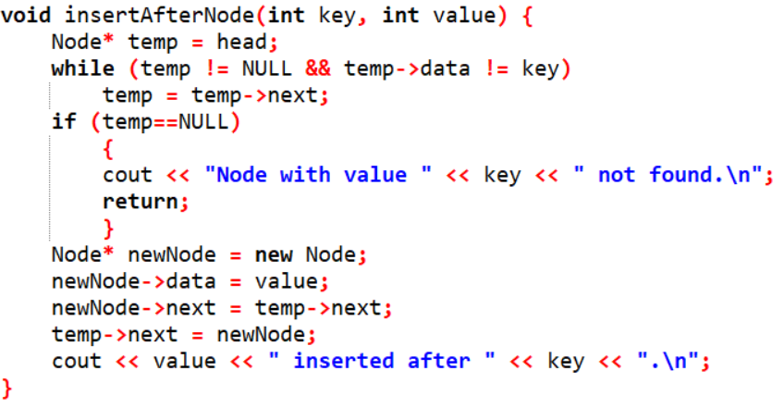
Insert Menu
Case 1:
head
NULL

Slide 24
Insert Menu
Case 1:
temp
head
NULL

Slide 25
Insert Menu
Case 1:
temp
head
NULL

Slide 26
Insert Menu
Case 1:
temp
head
NULL

Slide 27
Insert Menu
Case 1:
temp
head
NULL

Slide 28
Insert Menu
Case 2: Key=31, value-45
head
10 | next
20 | next
31 | next
30 | next
NULL

Slide 29
Insert Menu
Case 2: Key=31, value-45
head
temp
10 | next
20 | next
31 | next
30 | next
NULL

Slide 30
Insert Menu
Case 2: Key=31, value-45
head
temp
10 | next
20 | next
31 | next
30 | next
NULL

Slide 31
Insert Menu
Case 2: Key=31, value-45
head
temp
10 | next
20 | next
31 | next
30 | next
NULL

Slide 32
Insert Menu
Case 2: Key=31, value-45
head
temp
10 | next
20 | next
31 | next
30 | next
NULL

Slide 33
Insert Menu
Case 2: Key=31, value-45
head
temp
10 | next
20 | next
31 | next
30 | next
NULL

Slide 34
Insert Menu
Case 2: Key=31, value-45
Key Matched
head
temp
10 | next
20 | next
31 | next
30 | next
NULL

Slide 35
Insert Menu
Case 2: Key=31, value-45
Key Matched
head
temp
10 | next
20 | next
31 | next
30 | next
NULL

Slide 36
Insert Menu
Case 2: Key=31, value-45
Key Matched
head
newNode
temp
10 | next
20 | next
31 | next
30 | next
-- | next
NULL

Slide 37
Insert Menu
Case 2: Key=31, value-45
Key Matched
head
newNode
temp
10 | next
20 | next
31 | next
30 | next
45 | next
NULL

Slide 38
Insert Menu
Case 2: Key=31, value-45
Key Matched
newNode
45 | next
head
temp
10 | next
20 | next
31 | next
30 | next
NULL

Slide 39
Insert Menu
Case 2: Key=31, value-45
Key Matched
newNode
45 | next
head
temp
10 | next
20 | next
31 | next
30 | next
NULL

Slide 40
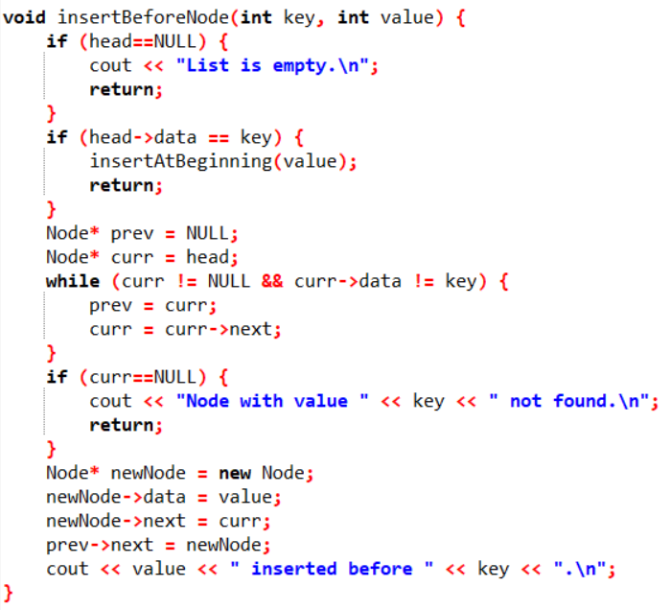
Insert Menu

Slide 41
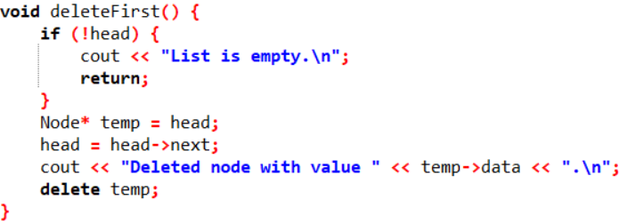
Delete Menu

Slide 42
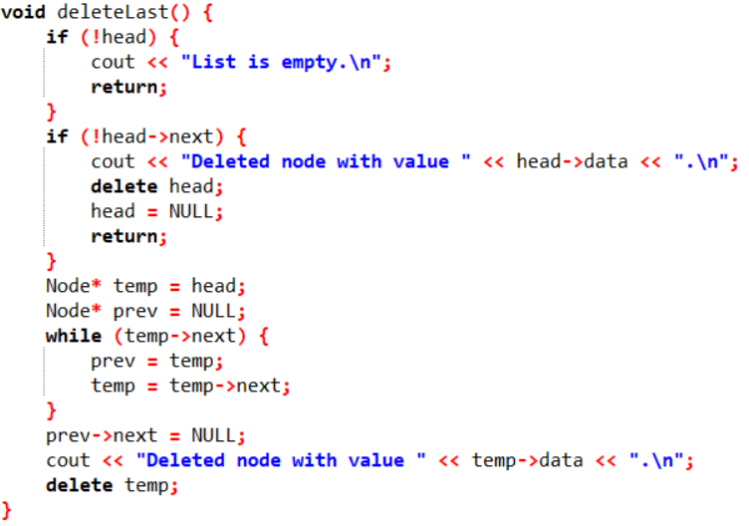
Delete Menu

Slide 43
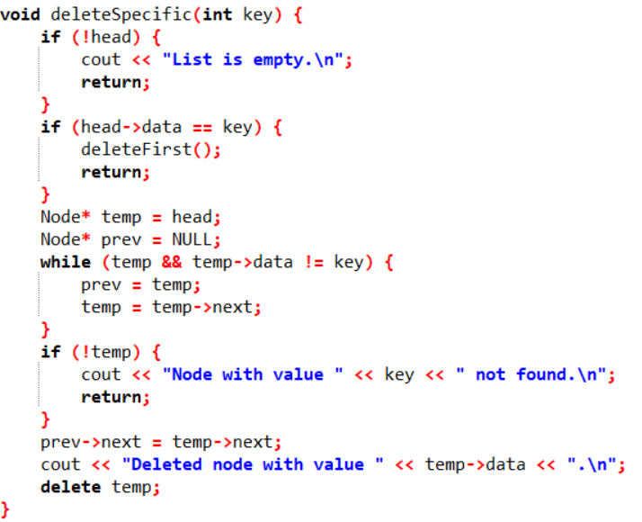
Delete Menu

